Slide 1
Flying transport
Filimonov Stepan RL6-31

Slide 2
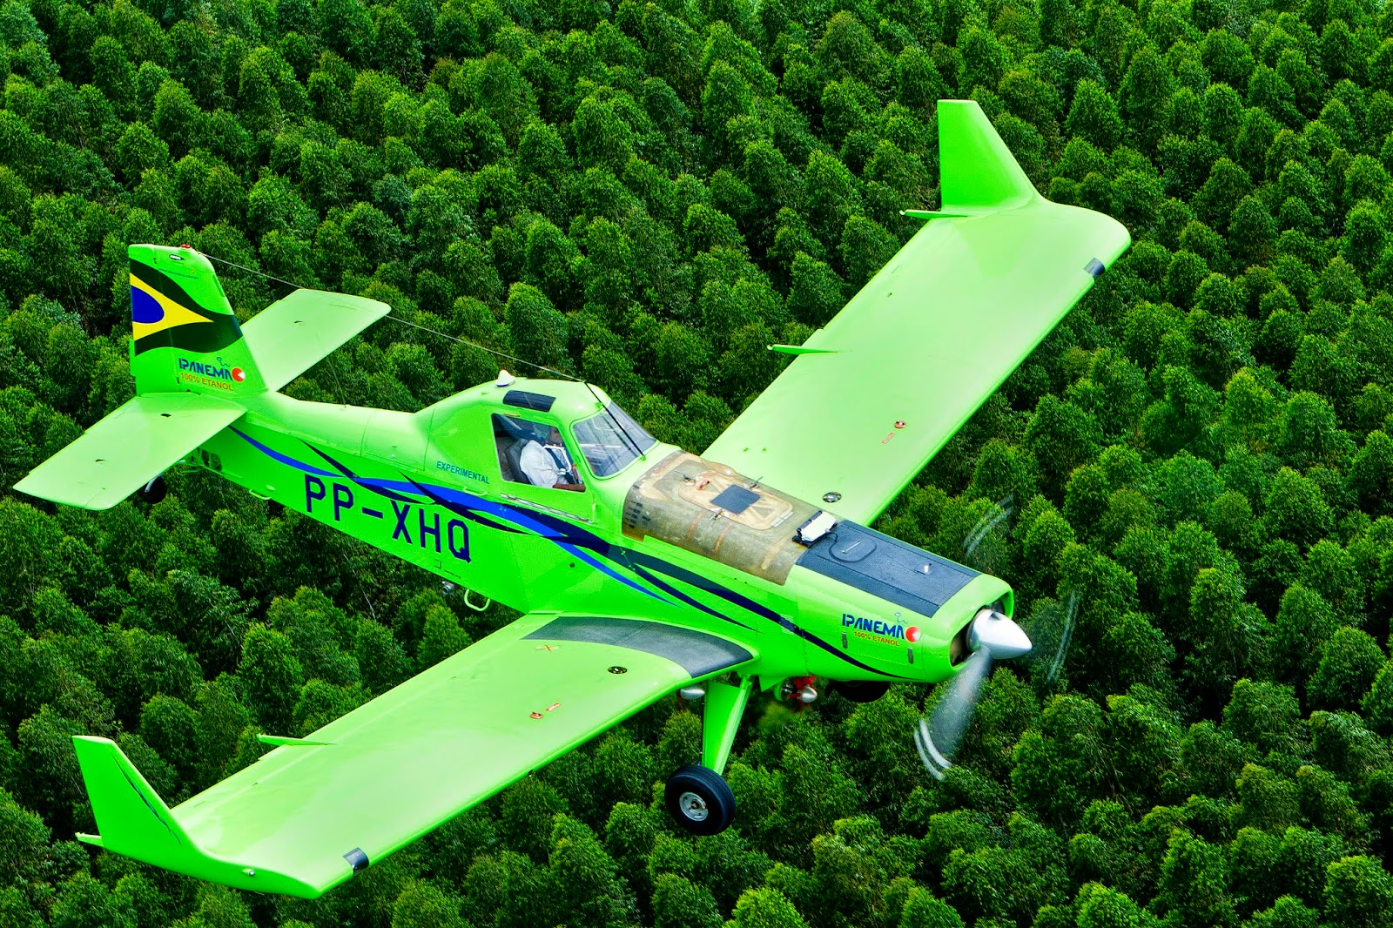
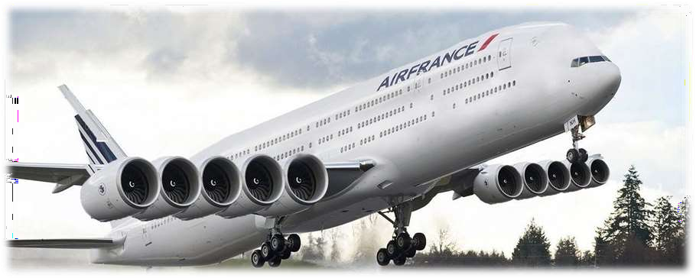
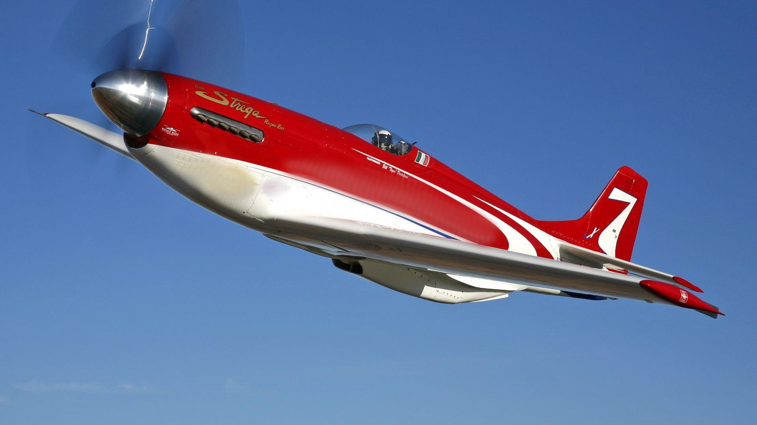
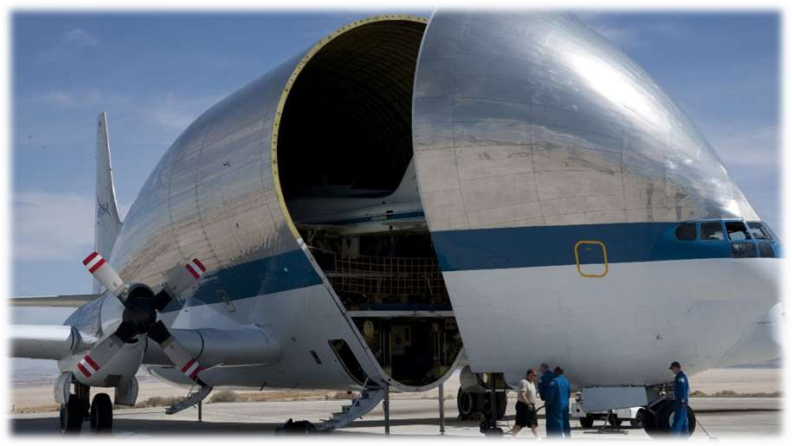
Civil aircraft

Slide 3
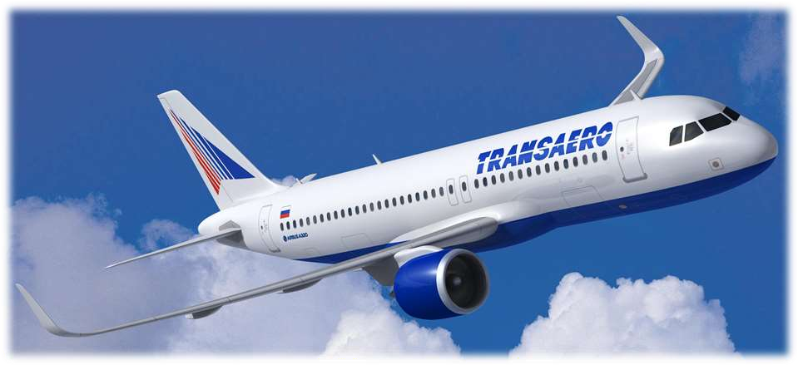
Passenger planes are designed and equipped to carry passengers and luggage. They have separate compartments for transporting people and cargo.

Slide 4
Transport aircraft is an aircraft designed to transport various goods.Often the same aircraft is cargo and passenger, only the equipment changes.

Slide 5
Agricultural aircraft - used for agricultural work. Most often, agricultural aviation is used for spraying fertilizers on agricultural crops, as well as for fertilizing crops.

Slide 6
Sports plane is an aircraft designed for training, training and competitions of pilots-athletes. The most important features of sports aircraft are their small weight, ease of control, and the possibility of long flights with heavy overloads.

Slide 7
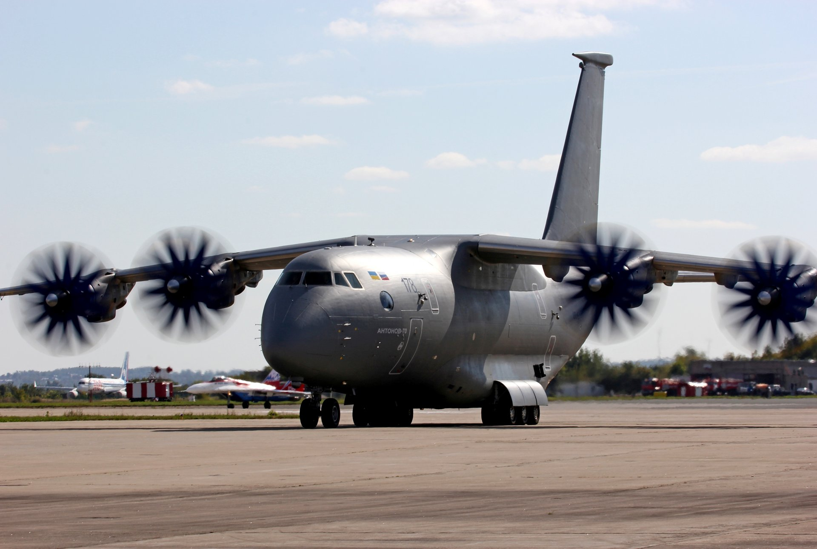
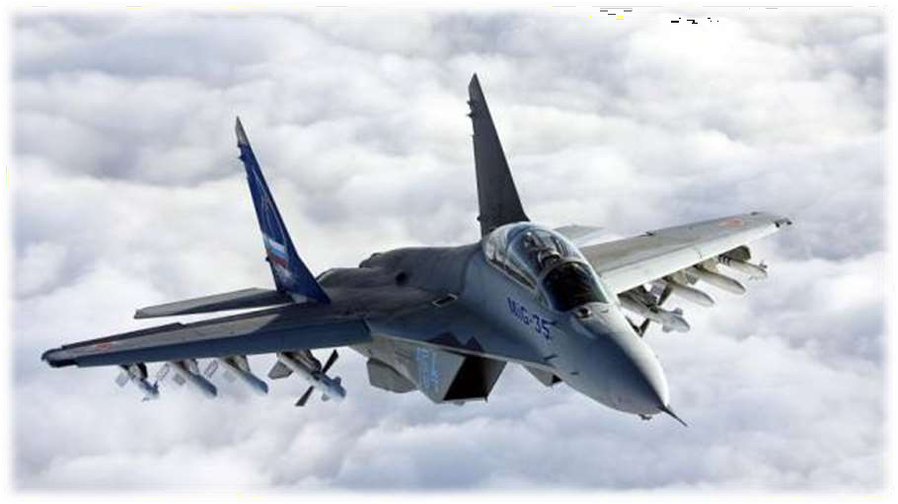
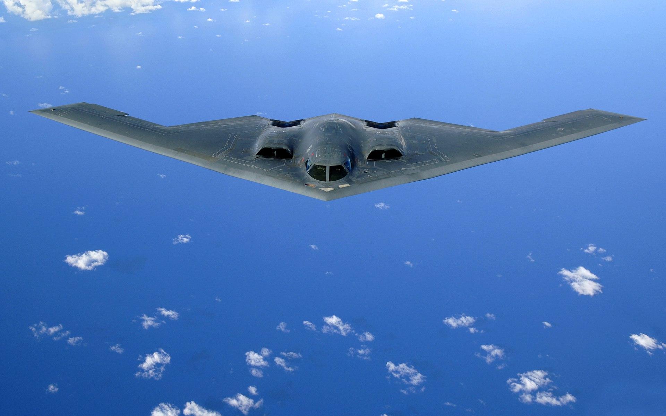
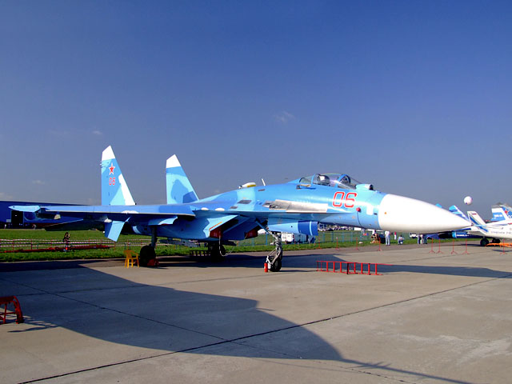
Military aircraft

Slide 8
A fighter is a military aircraft designed primarily to destroy enemy air targets. It is used to gain air supremacy over the enemy.

Slide 9
A strategic bomber is a combat aircraft capable of carrying aviation weapons, including nuclear weapons, intended for bombing or missile strikes on strategically significant objects located on the territory of a hostile state.

Slide 10
Military transport aircraft is a transport aircraft designed to deliver troops, weapons and other military equipment.

Slide 11


